Slide 1


Measures of Central Tendency
Session No.: 01 Course Name: Probability and statistics Course Code: C1UC322T Duration:50 Minutes

Slide 2
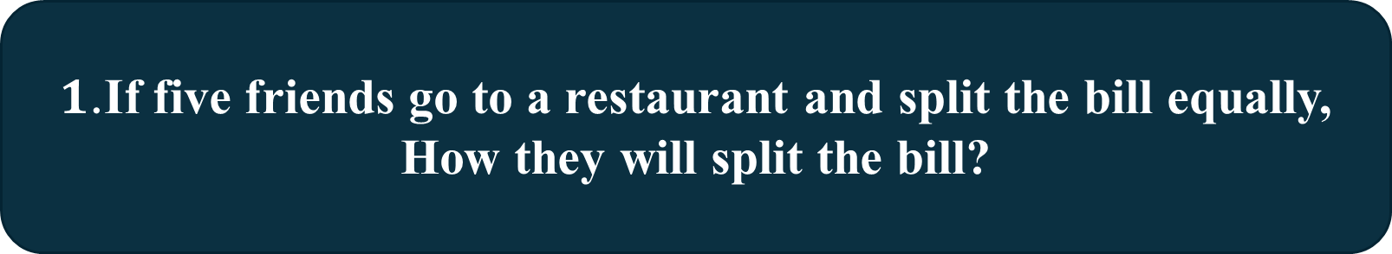
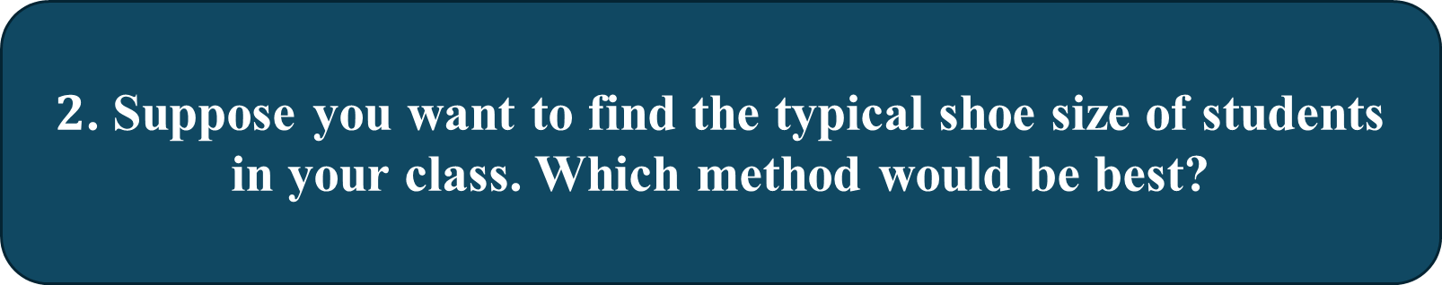
1.If five friends go to a restaurant and split the bill equally, How they will split the bill?
Opening Activity

Slide 3
At the end of this session students will be able to At the end of this lesson, students will be able to
Learning outcomes
Recognize the concept of measure of Central Tendency.
Interpret the Results in different contexts.

Slide 4
Session Outline
1 Introduction to Central Tendency
Arithmetic Mean (A. M.) of the data
2
3
Direct Method
4
Assumed mean method
5
Step-deviation method
6 Assessment

Slide 5
Measure of Central Tendency focuses on identifying a central or representative (Average) value within a dataset. It aims to describe a typical or middle value that summarizes the distribution of data.
There are two ways to measure of central tendency
1. Mathematical
2. Positional
Arithmetic Mean or Mean
Median
Harmonic Mean
Mode
Geometric Mean

Slide 6
Data (collection of information or facts)
Ungrouped data
Grouped data
Discrete frequency distribution
Continuous frequency distribution

Slide 7
Dataset and its categories
Data: It is a collection of facts or observation or measurement that are used for analysis and decision -making
12,12,11,14,15,13,17,18,19,20,12,11,12,12,19,17,18,12,15,15,15,16
Marks | No.of students
11 | 2
12 | 6
13 | 1
14 | 1
15 | 4
16 | 1
17 | 2
18 | 2
19 | 2
20 | 1
Clas interval of Marks | No. of Students
10-15 | 10
15-20 | 12
Continuous frequency distribution
Discrete frequency distribution
Individual data

Slide 8
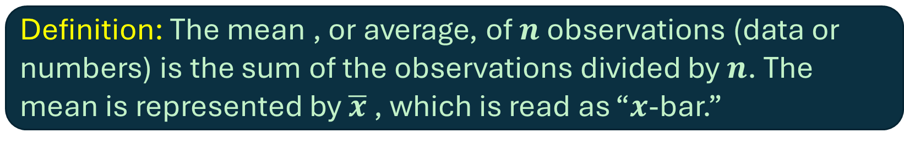
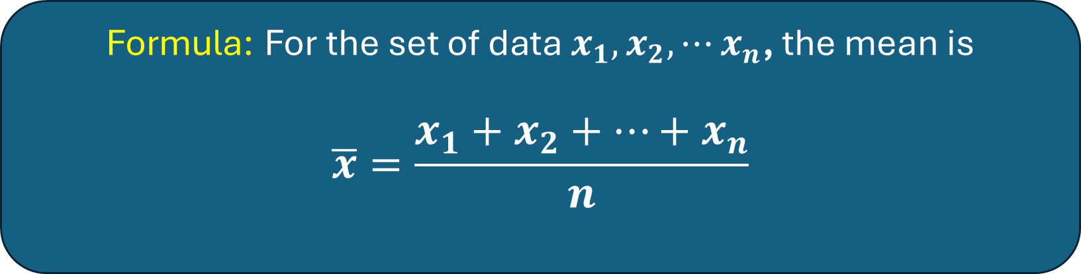
Arithmetic Mean (A. M.) for Individual (Ungrouped) Data

Slide 9
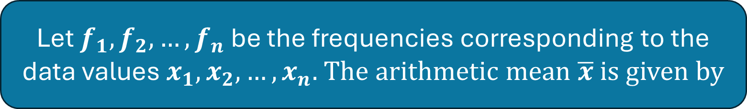
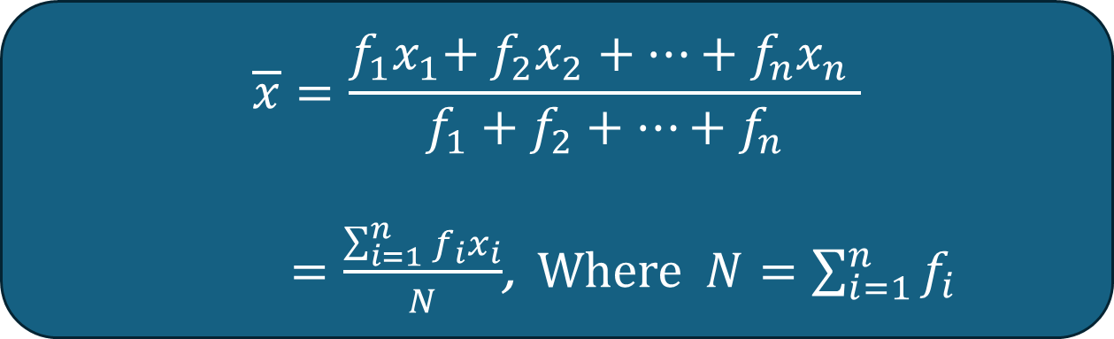
Arithmetic Mean for Grouped Data (Discrete Data with Frequency)

Slide 10
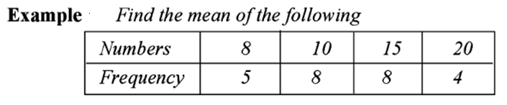
Activity-1 (Group Activity)

Slide 11
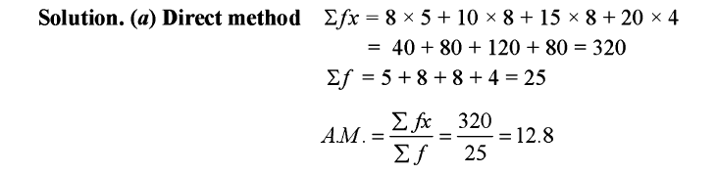

Slide 12
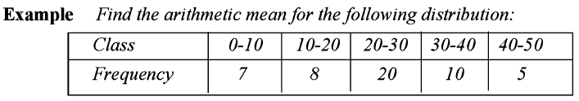

Slide 13
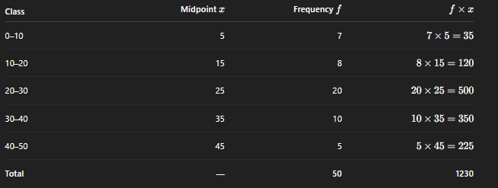

Direct Method

Slide 14
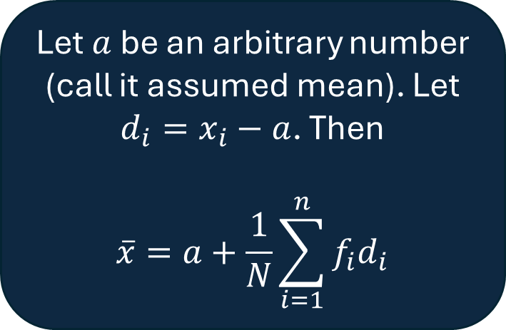
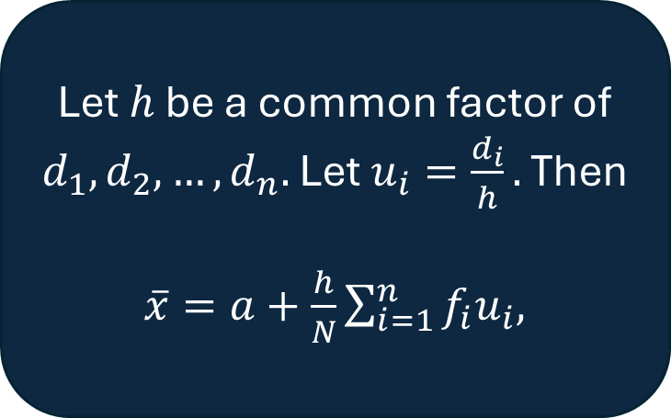
Short-cut Methods to Compute Mean
1. Assumed mean method
2. Step-deviation method

Slide 16
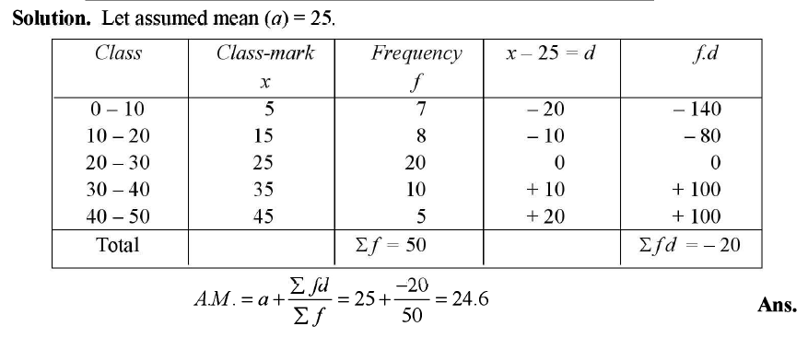
Using Assumed Mean Method

Slide 17
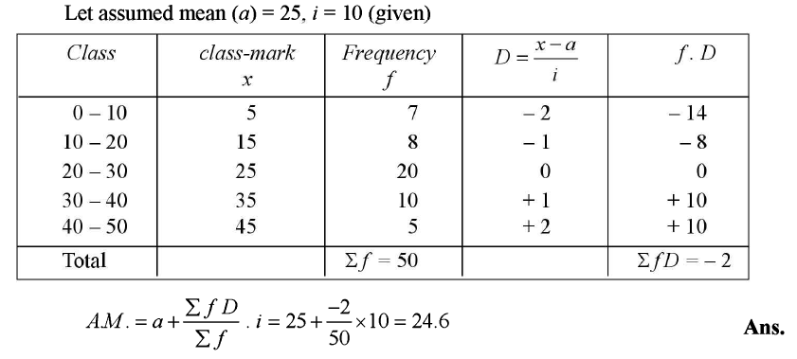
Using step-deviation method

Slide 18
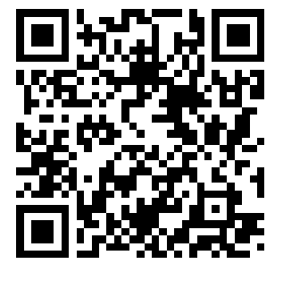
Activity-2 (Wooclap)
A school cafeteria tracks the number of sandwiches sold each day over a month. The data is large, so they organize it into the following grouped frequency table:
Number of Sandwiches Sold | Frequency (Number of Days)
20-30 | 5
30-40 | 8
40-50 | 12
50-60 | 10
60-70 | 5
Calculate the mean number of Sandwiches sold per day.

Slide 19
Reflection:
The mean number of sandwiches sold per day is 45.5.
The cafeteria can prepare around 45–46 sandwiches daily as a general estimate.

Slide 20
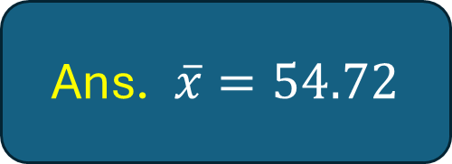
Assessment
Question: Find the mean of the following frequency distribution

Slide 21
Exit Ticket:
"In one sentence, explain why grouped data is sometimes more useful than ungrouped data when calculating the mean."

Slide 22
In the next lesson we will learn the concept of Weighted Arithmetic Mean and Median of a data

